Slide 1

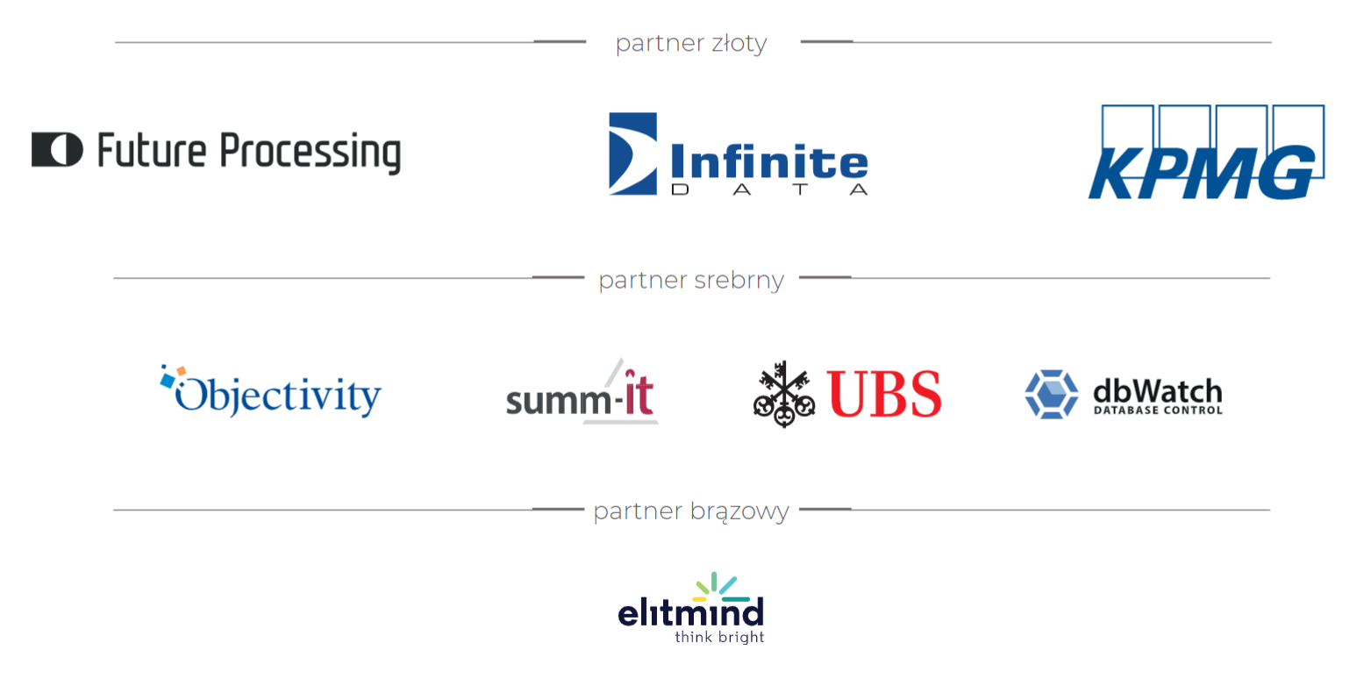

Slide 2

HOW TO BECOME A BETTER DATA ENGINNER
Sławomir Drzymała

Slide 3

how to become a better data enginner?
“data engineer” as a shortcut for all of us

Slide 4
how to become a better data enginner?
exceptional data engineer?

Slide 5
how to become a better data enginner?
knows internals inside out?

Slide 6
how to become a better data enginner?
you are here, well done!

Slide 7
how to become a better data enginner?
also quality, co-op and delivering

Slide 8
how to become a better data enginner?
about me

Slide 9
about me
dwh developer +

Slide 10
about me
@sdrzymala

Slide 11
about me
pl.seequality.net

Slide 12
how to become a better data enginner?
my top 10

Slide 13
how to become a better data enginner?
what to do and what to learn

Slide 14
how to become a better data enginner?
learn git
1
Notes:
Resources:
https://learngitbranching.js.org
https://kursgita.pl
https://www.atlassian.com/git
https://docs.github.com/en/get-started/quickstart/set-up-git
https://www.reddit.com/r/learnprogramming/comments/66u0v7/what_is_the_best_tutorial_to_learn_both_gitgithub/
https://news.ycombinator.com/item?id=24586436

Slide 15
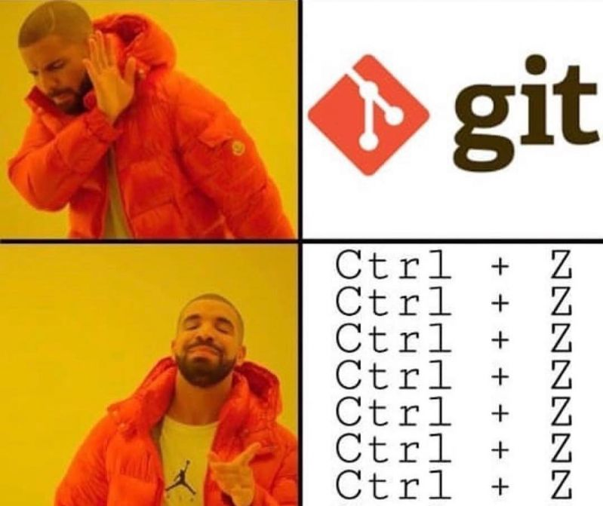
learn git

Slide 16
learn git
more than just a commit

Slide 17
learn git
branching and merging strategy
Notes:
Resources:
https://www.atlassian.com/continuous-delivery/continuous-integration/trunk-based-development

Slide 18
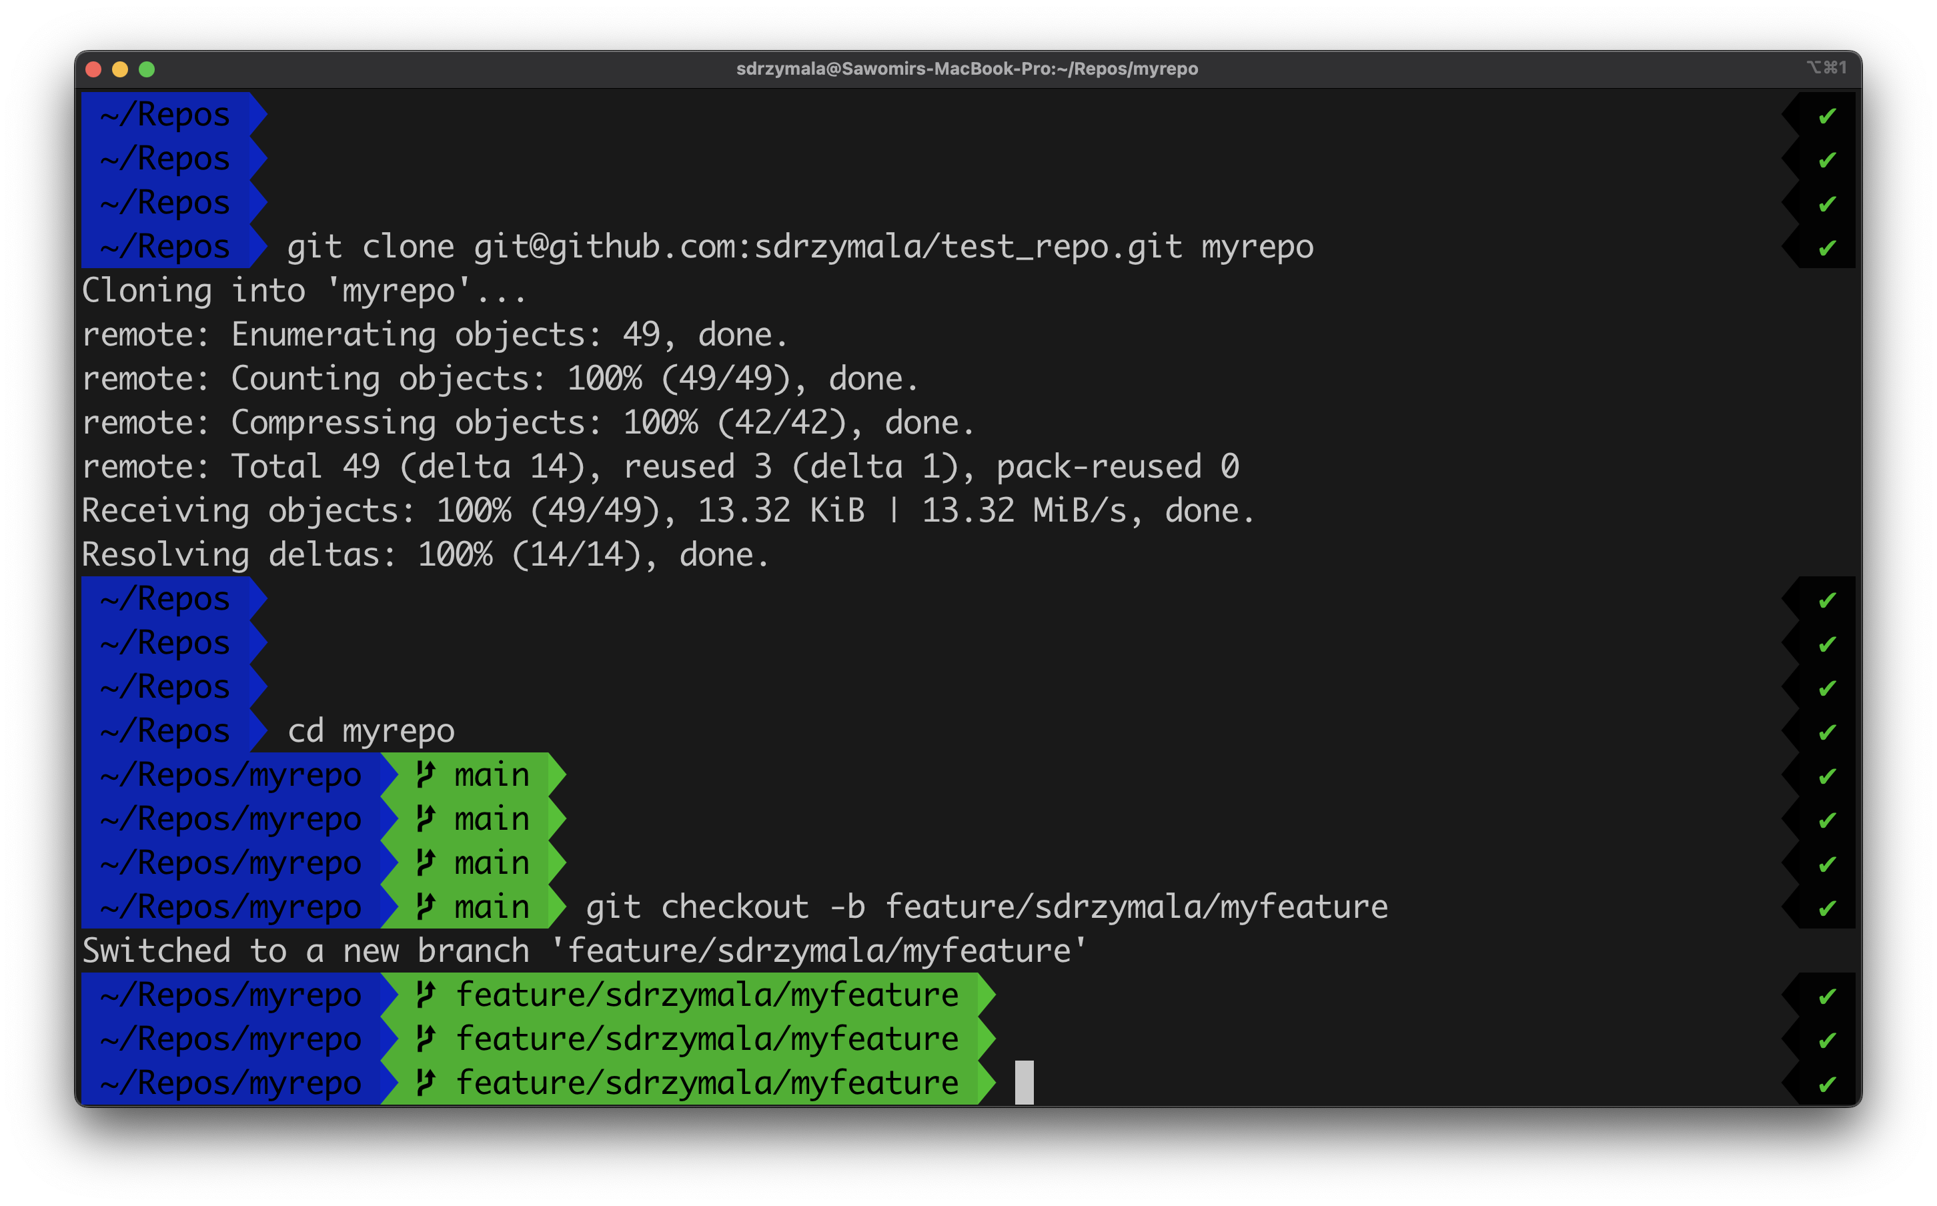
learn git

Slide 19
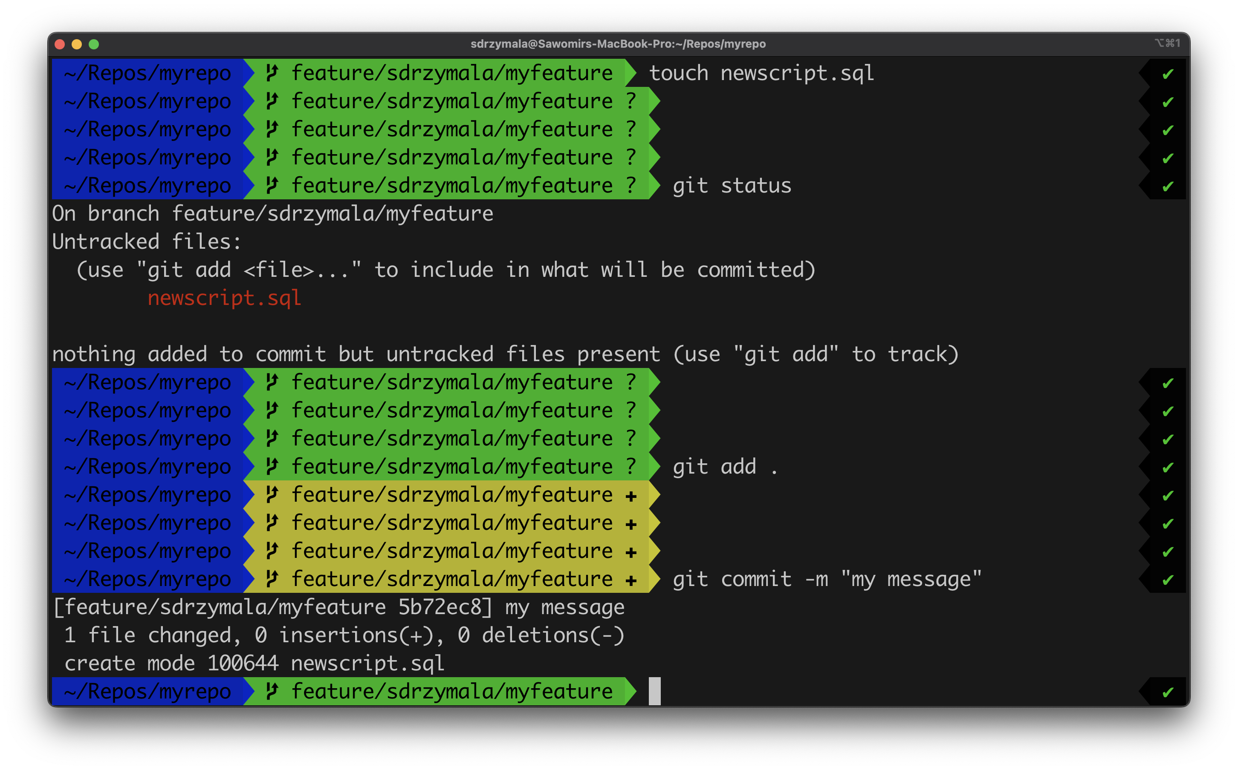
learn git

Slide 20
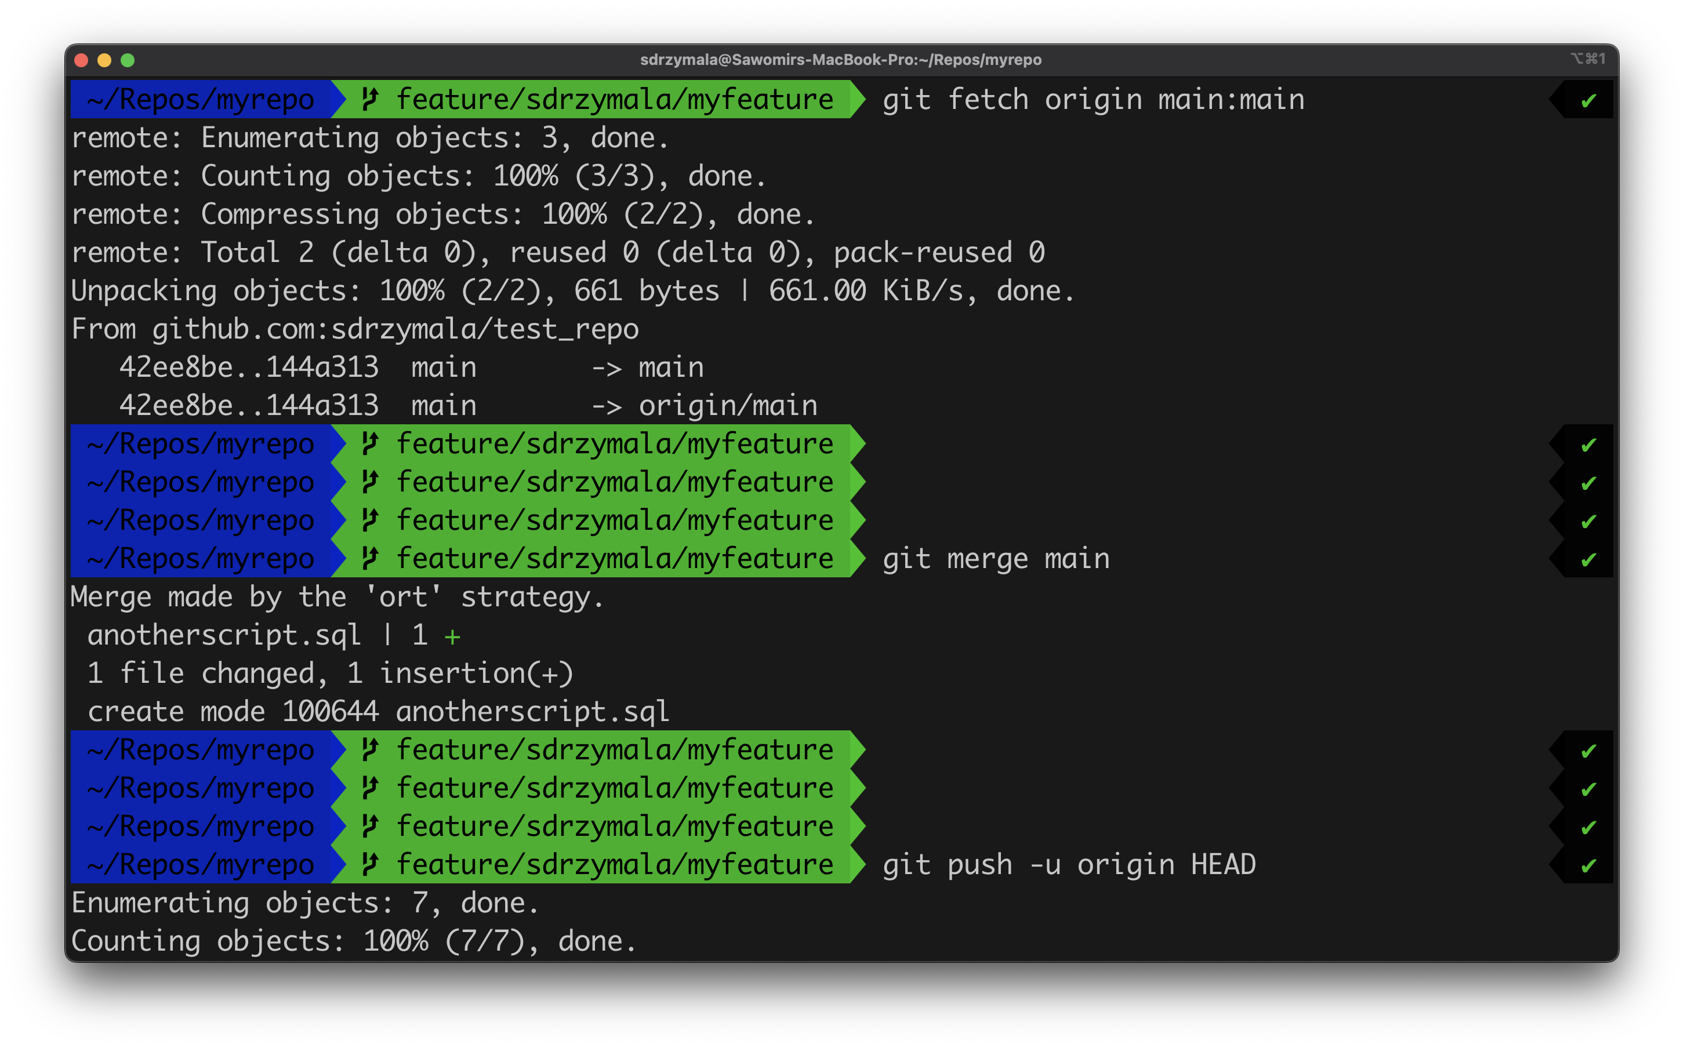
learn git

Slide 21
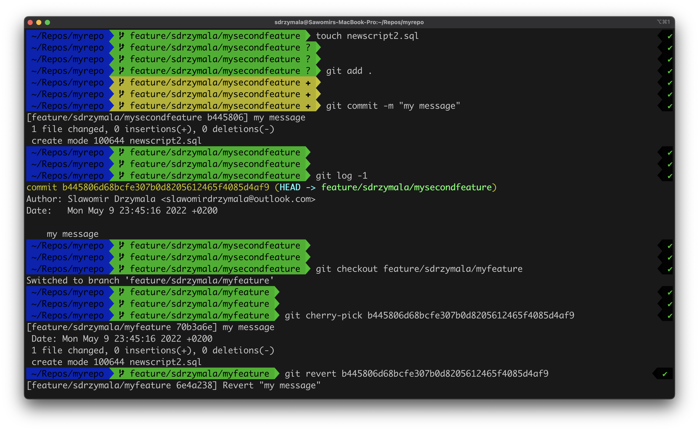
learn git

Slide 22
learn git
gui or console?

Slide 23
how to become a better data enginner?
learn git
1

Slide 24
how to become a better data enginner?
ask for code review (properly)
2

Slide 25
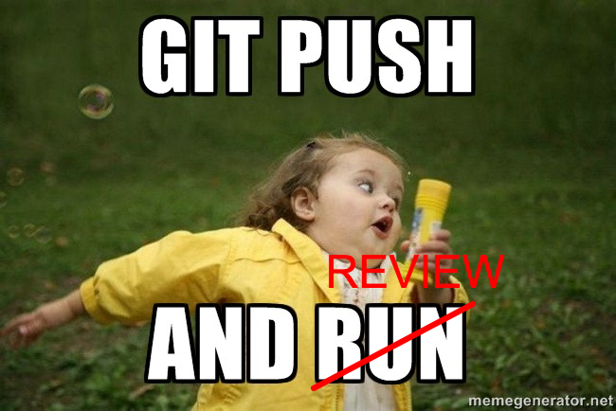
learn git

Slide 26
ask for code review (properly)
quality pull requests

Slide 27
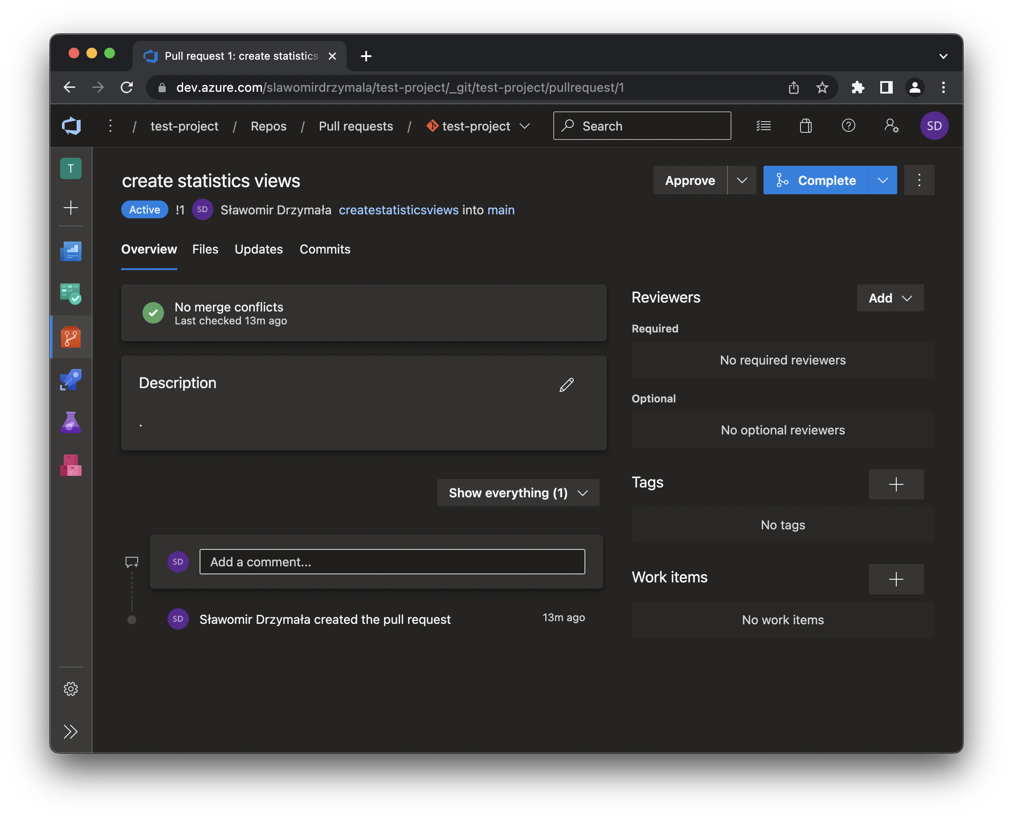
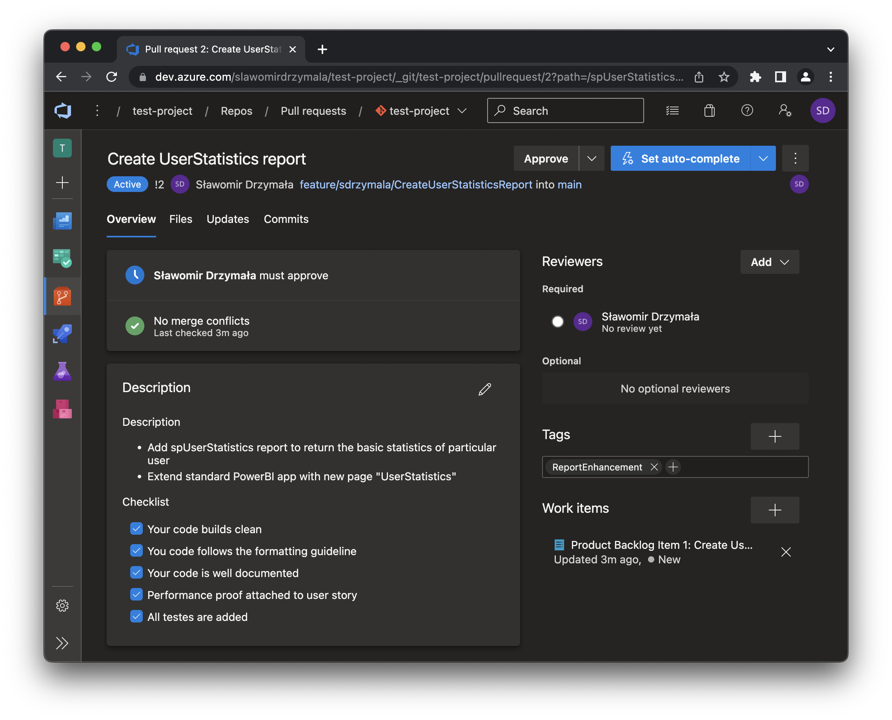
ask for code review (properly)

Slide 28
ask for code review (properly)
pull request templates
Notes:
Resources: https://docs.github.com/en/communities/using-templates-to-encourage-useful-issues-and-pull-requests/creating-a-pull-request-template-for-your-repository

Slide 29
ask for code review (properly)
before handing over

Slide 30
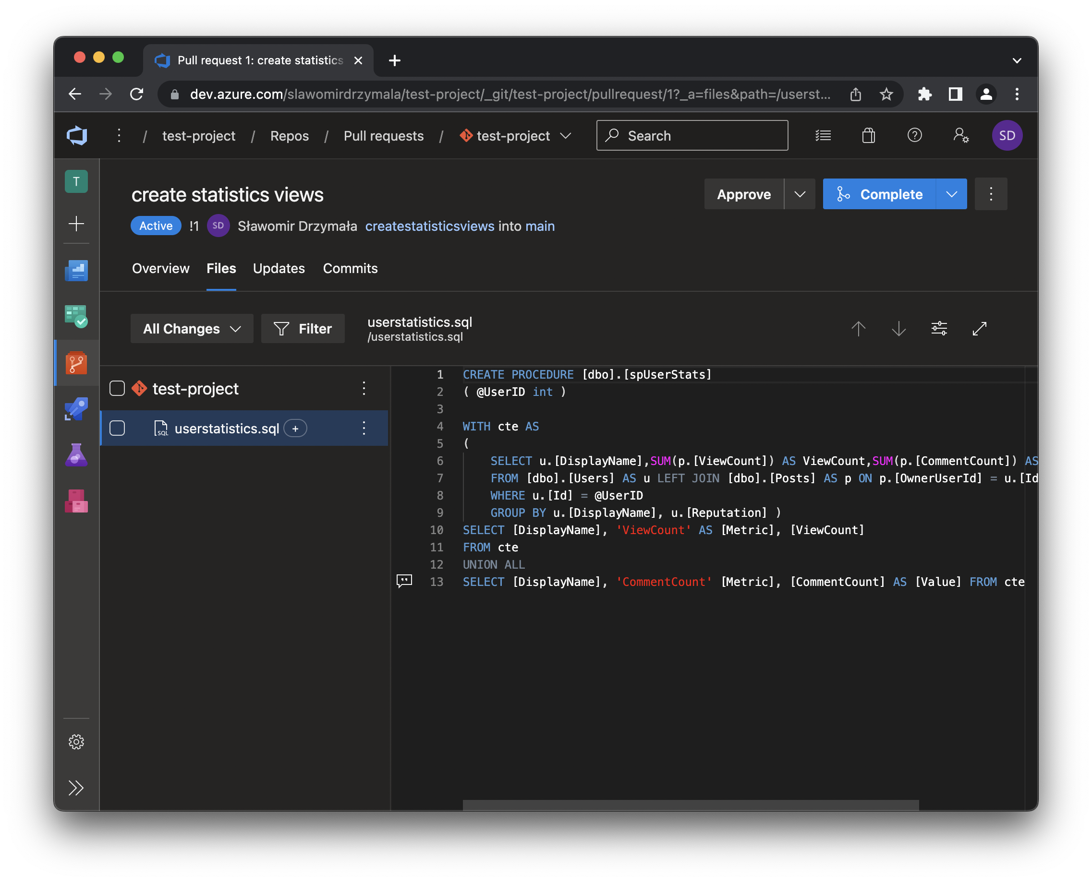
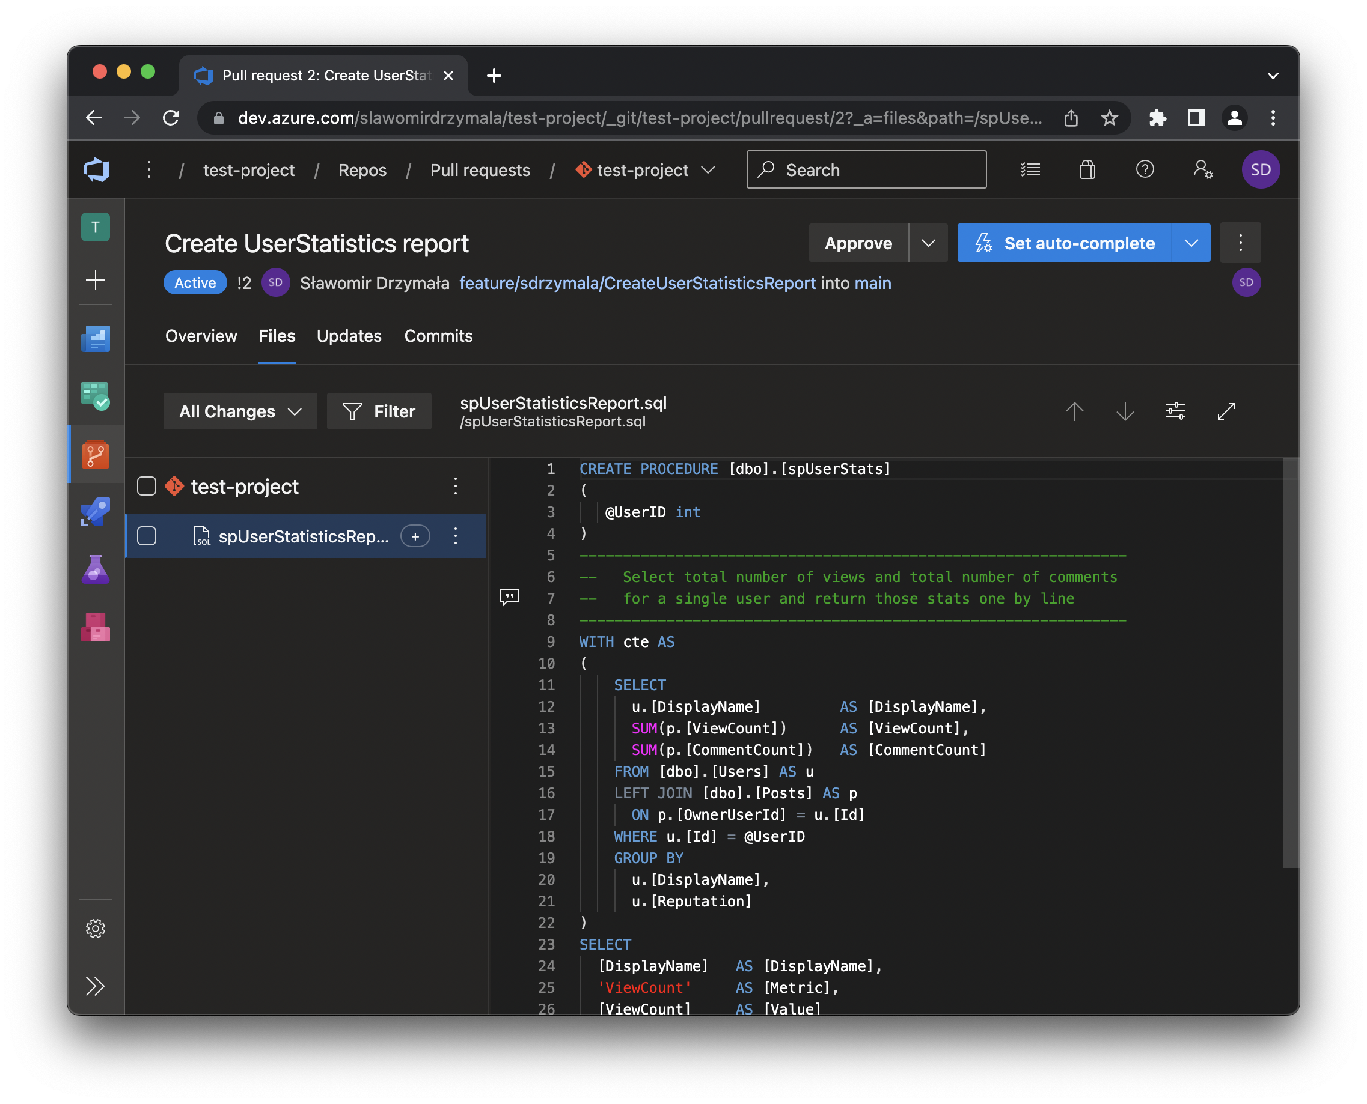
ask for code review (properly)
query itself coming from sqlsunday get slides for bonus t-sql trick
Notes:
Resources: https://sqlsunday.com/2020/12/01/run-your-cte-just-once-and-reuse-output/

Slide 31
how to become a better data enginner?
ask for code review (properly)
2

Slide 32
how to become a better data enginner?
do the code review (properly)
2.5
Notes:
Resources
https://www.morling.dev/blog/the-code-review-pyramid/

Slide 33
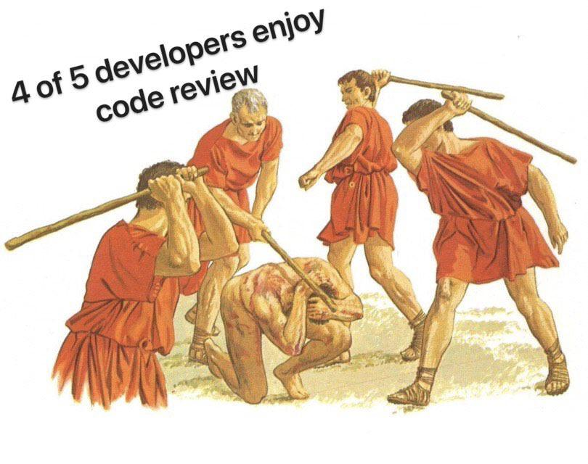
do the code review (properly)

Slide 34
do the code review (properly)
do the code review (properly)

Slide 35
do the code review (properly)
become a hacker

Slide 36
do the code review (properly)
code review checklist
Notes:
Resources:
https://www.evoketechnologies.com/blog/code-review-checklist-perform-effective-code-reviews/

Slide 37
do the code review (properly)
give clear and extensive feedback

Slide 38
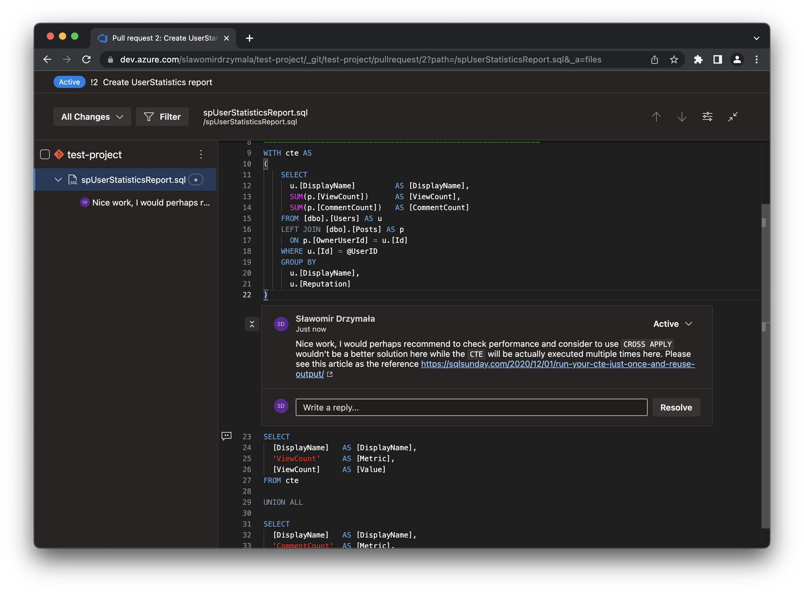
do the code review (properly)

Slide 39
do the code review (properly)
time for code review

Slide 40
how to become a better data enginner?
do the code review (properly)
2.5

Slide 41
how to become a better data enginner?
don’t be afraid of complex tasks
3

Slide 42

don’t be afraid of complex tasks

Slide 43
don’t be afraid of complex tasks
an opportunity to learn

Slide 44
don’t be afraid of complex tasks
tech and business knowledge

Slide 45
don’t be afraid of complex tasks
business knowledge also matter

Slide 46
don’t be afraid of complex tasks
there is always a team

Slide 47
how to become a better data enginner?
don’t be afraid of complex tasks
3

Slide 48
how to become a better data enginner?
don’t be afraid to speak up
4

Slide 49
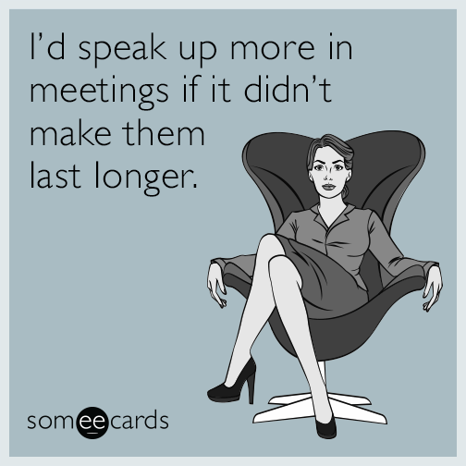
don’t be afraid to speak up

Slide 50
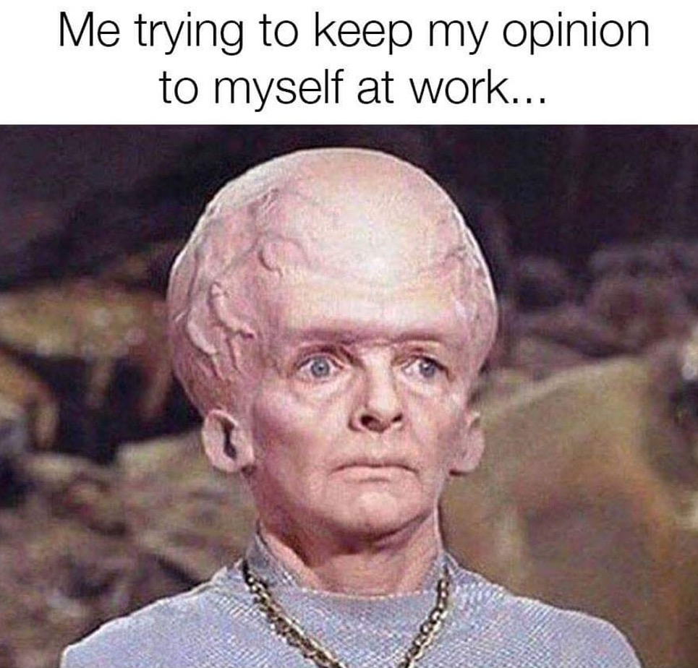
don’t be afraid to speak up

Slide 51
don’t be afraid to speak up
either you or they are wrong

Slide 52
don’t be afraid to speak up
speak up

Slide 53
don’t be afraid to speak up
at least to your buddy

Slide 54
don’t be afraid to speak up
big changes are always not a single person decision

Slide 55
how to become a better data enginner?
don’t be afraid to speak up
4

Slide 56
how to become a better data enginner?
don’t be afraid to ask for help
5

Slide 57
don’t be afraid to ask for help
two types of developers

Slide 58
don’t be afraid to ask for help
but ask for help properly

Slide 59
how to become a better data enginner?
don’t be afraid to ask for help
5

Slide 60
how to become a better data enginner?
start using documentation
6
Notes:
Discussion: https://www.reddit.com/r/learnprogramming/comments/ll9zap/read_the_documentation_not_stack_overflow/

Slide 61
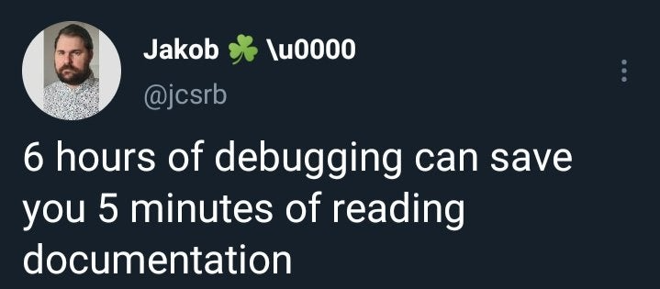
start using documentation

Slide 62
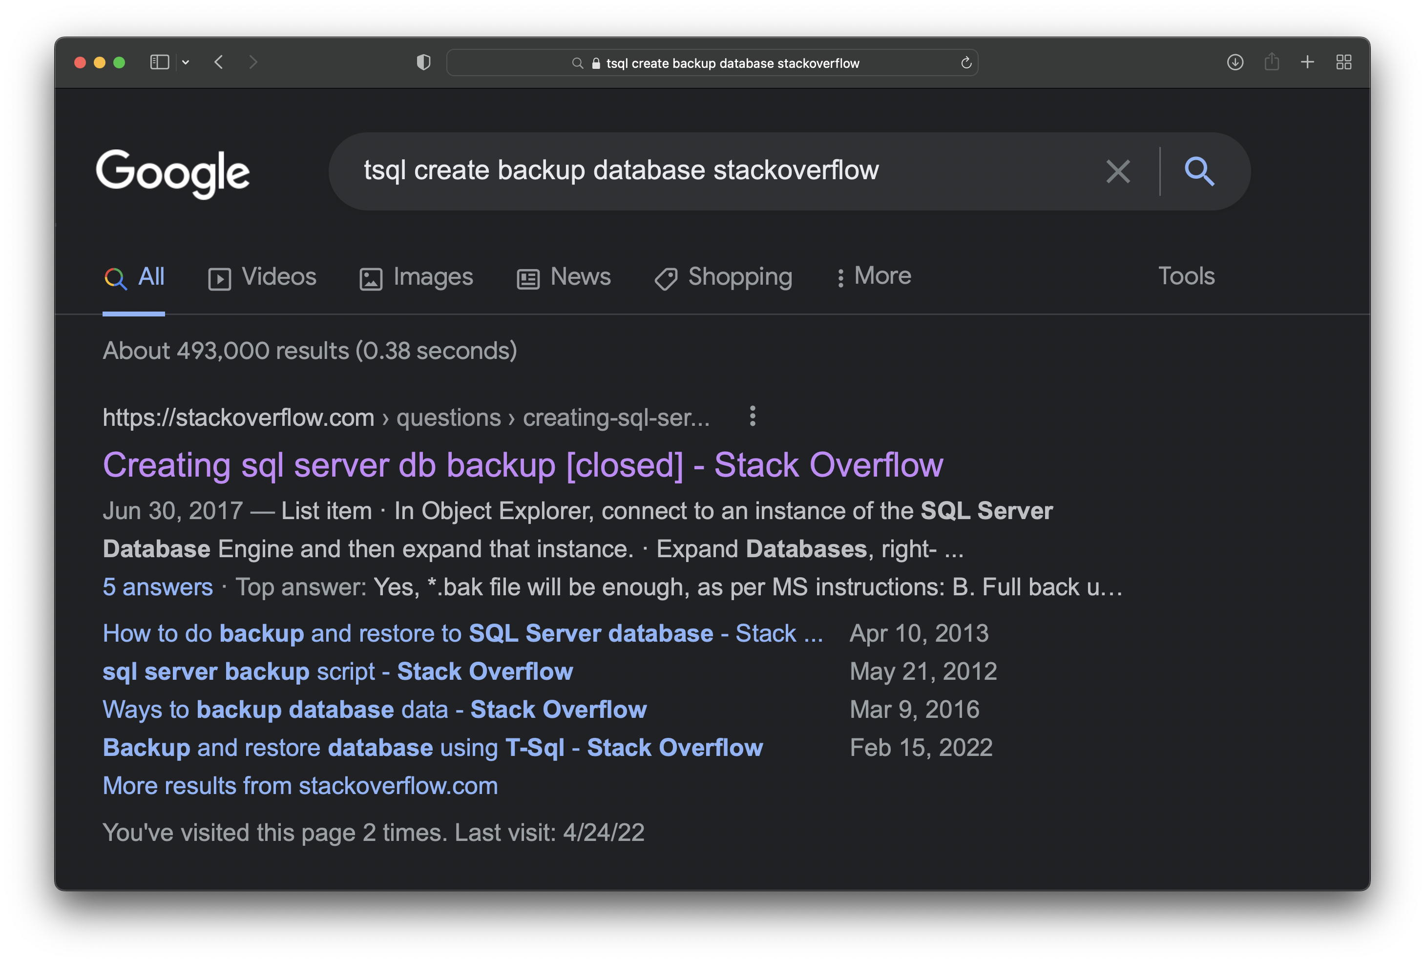
start using documentation

Slide 63
start using documentation
don’t just copy and paste

Slide 64
start using documentation
at least read the discussion

Slide 65
start using documentation
how about documentation?

Slide 66
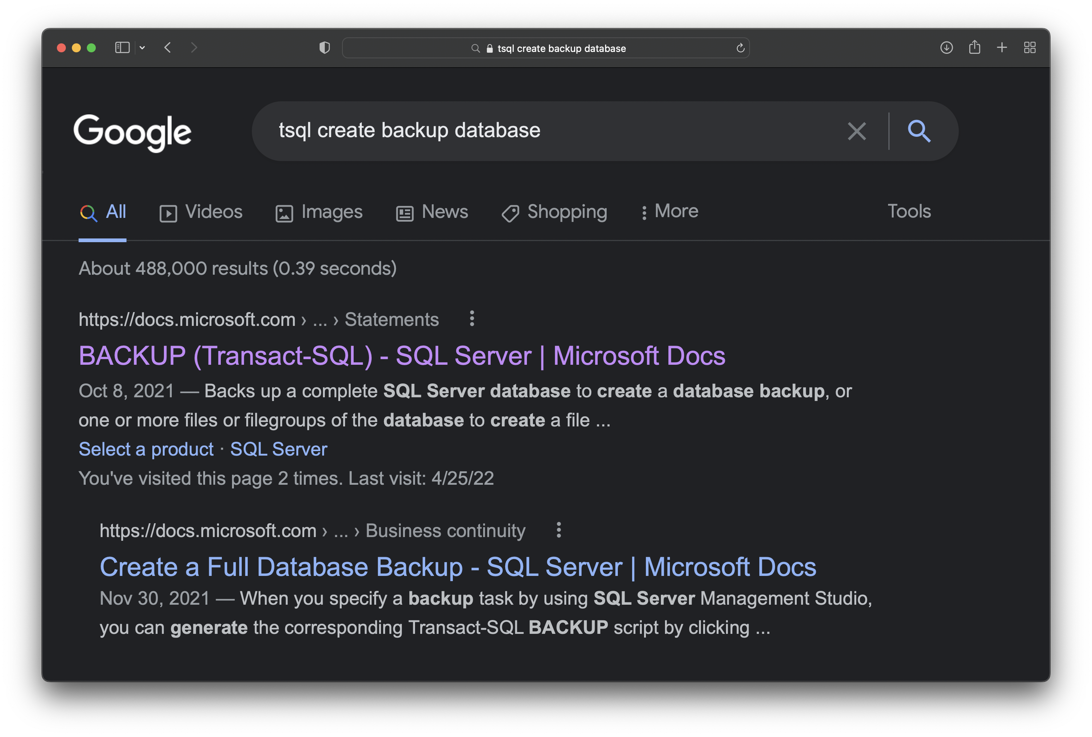
start using documentation

Slide 67
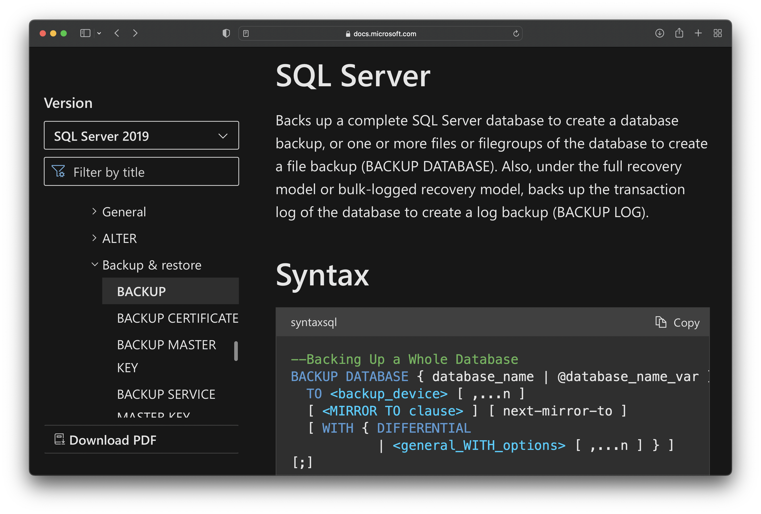
start using documentation

Slide 68
how to become a better data enginner?
start using documentation
6

Slide 69
how to become a better data enginner?
bonus - learn how to use google
Notes:
Resources
https://support.google.com/websearch/answer/2466433?visit_id=637882396817273763-3871659274&p=adv_operators&hl=en&rd=1

Slide 70
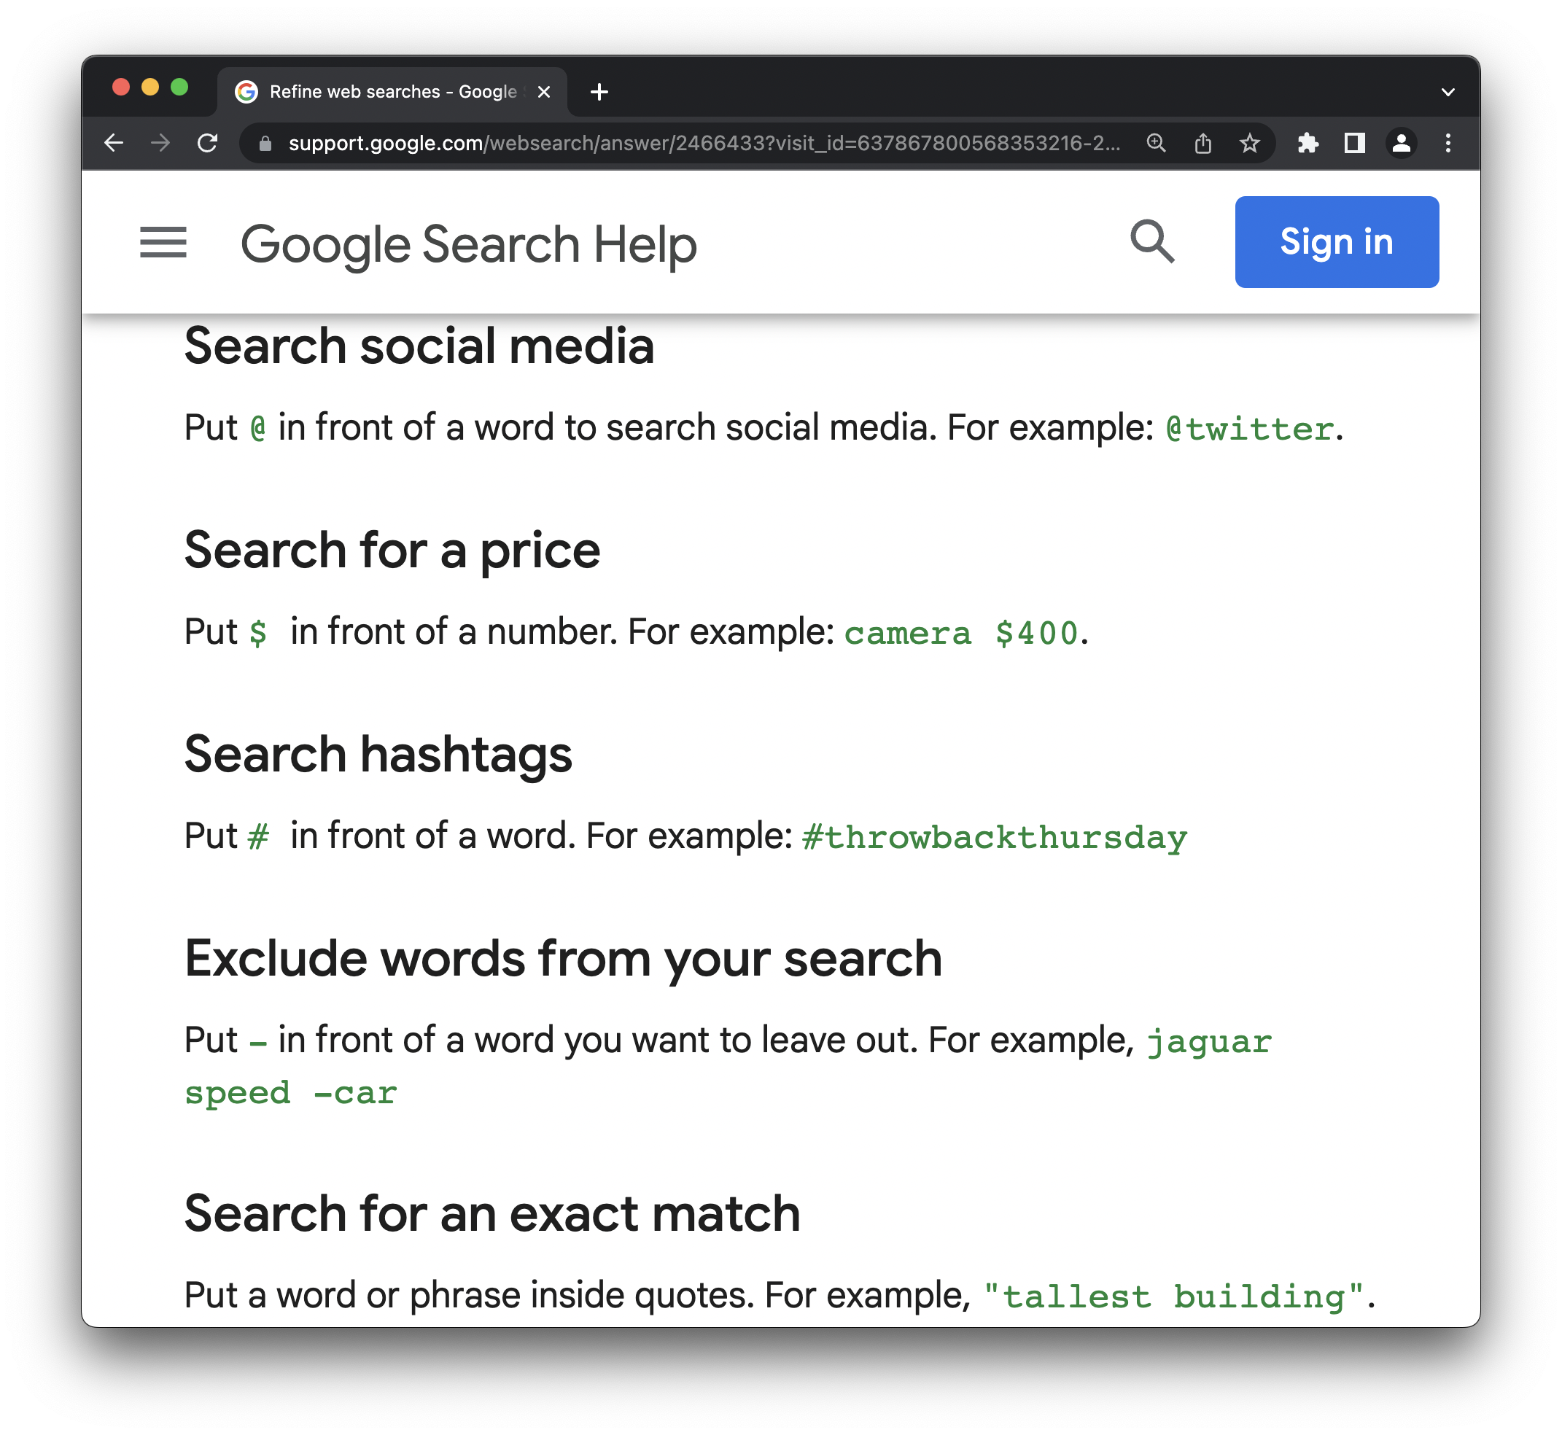
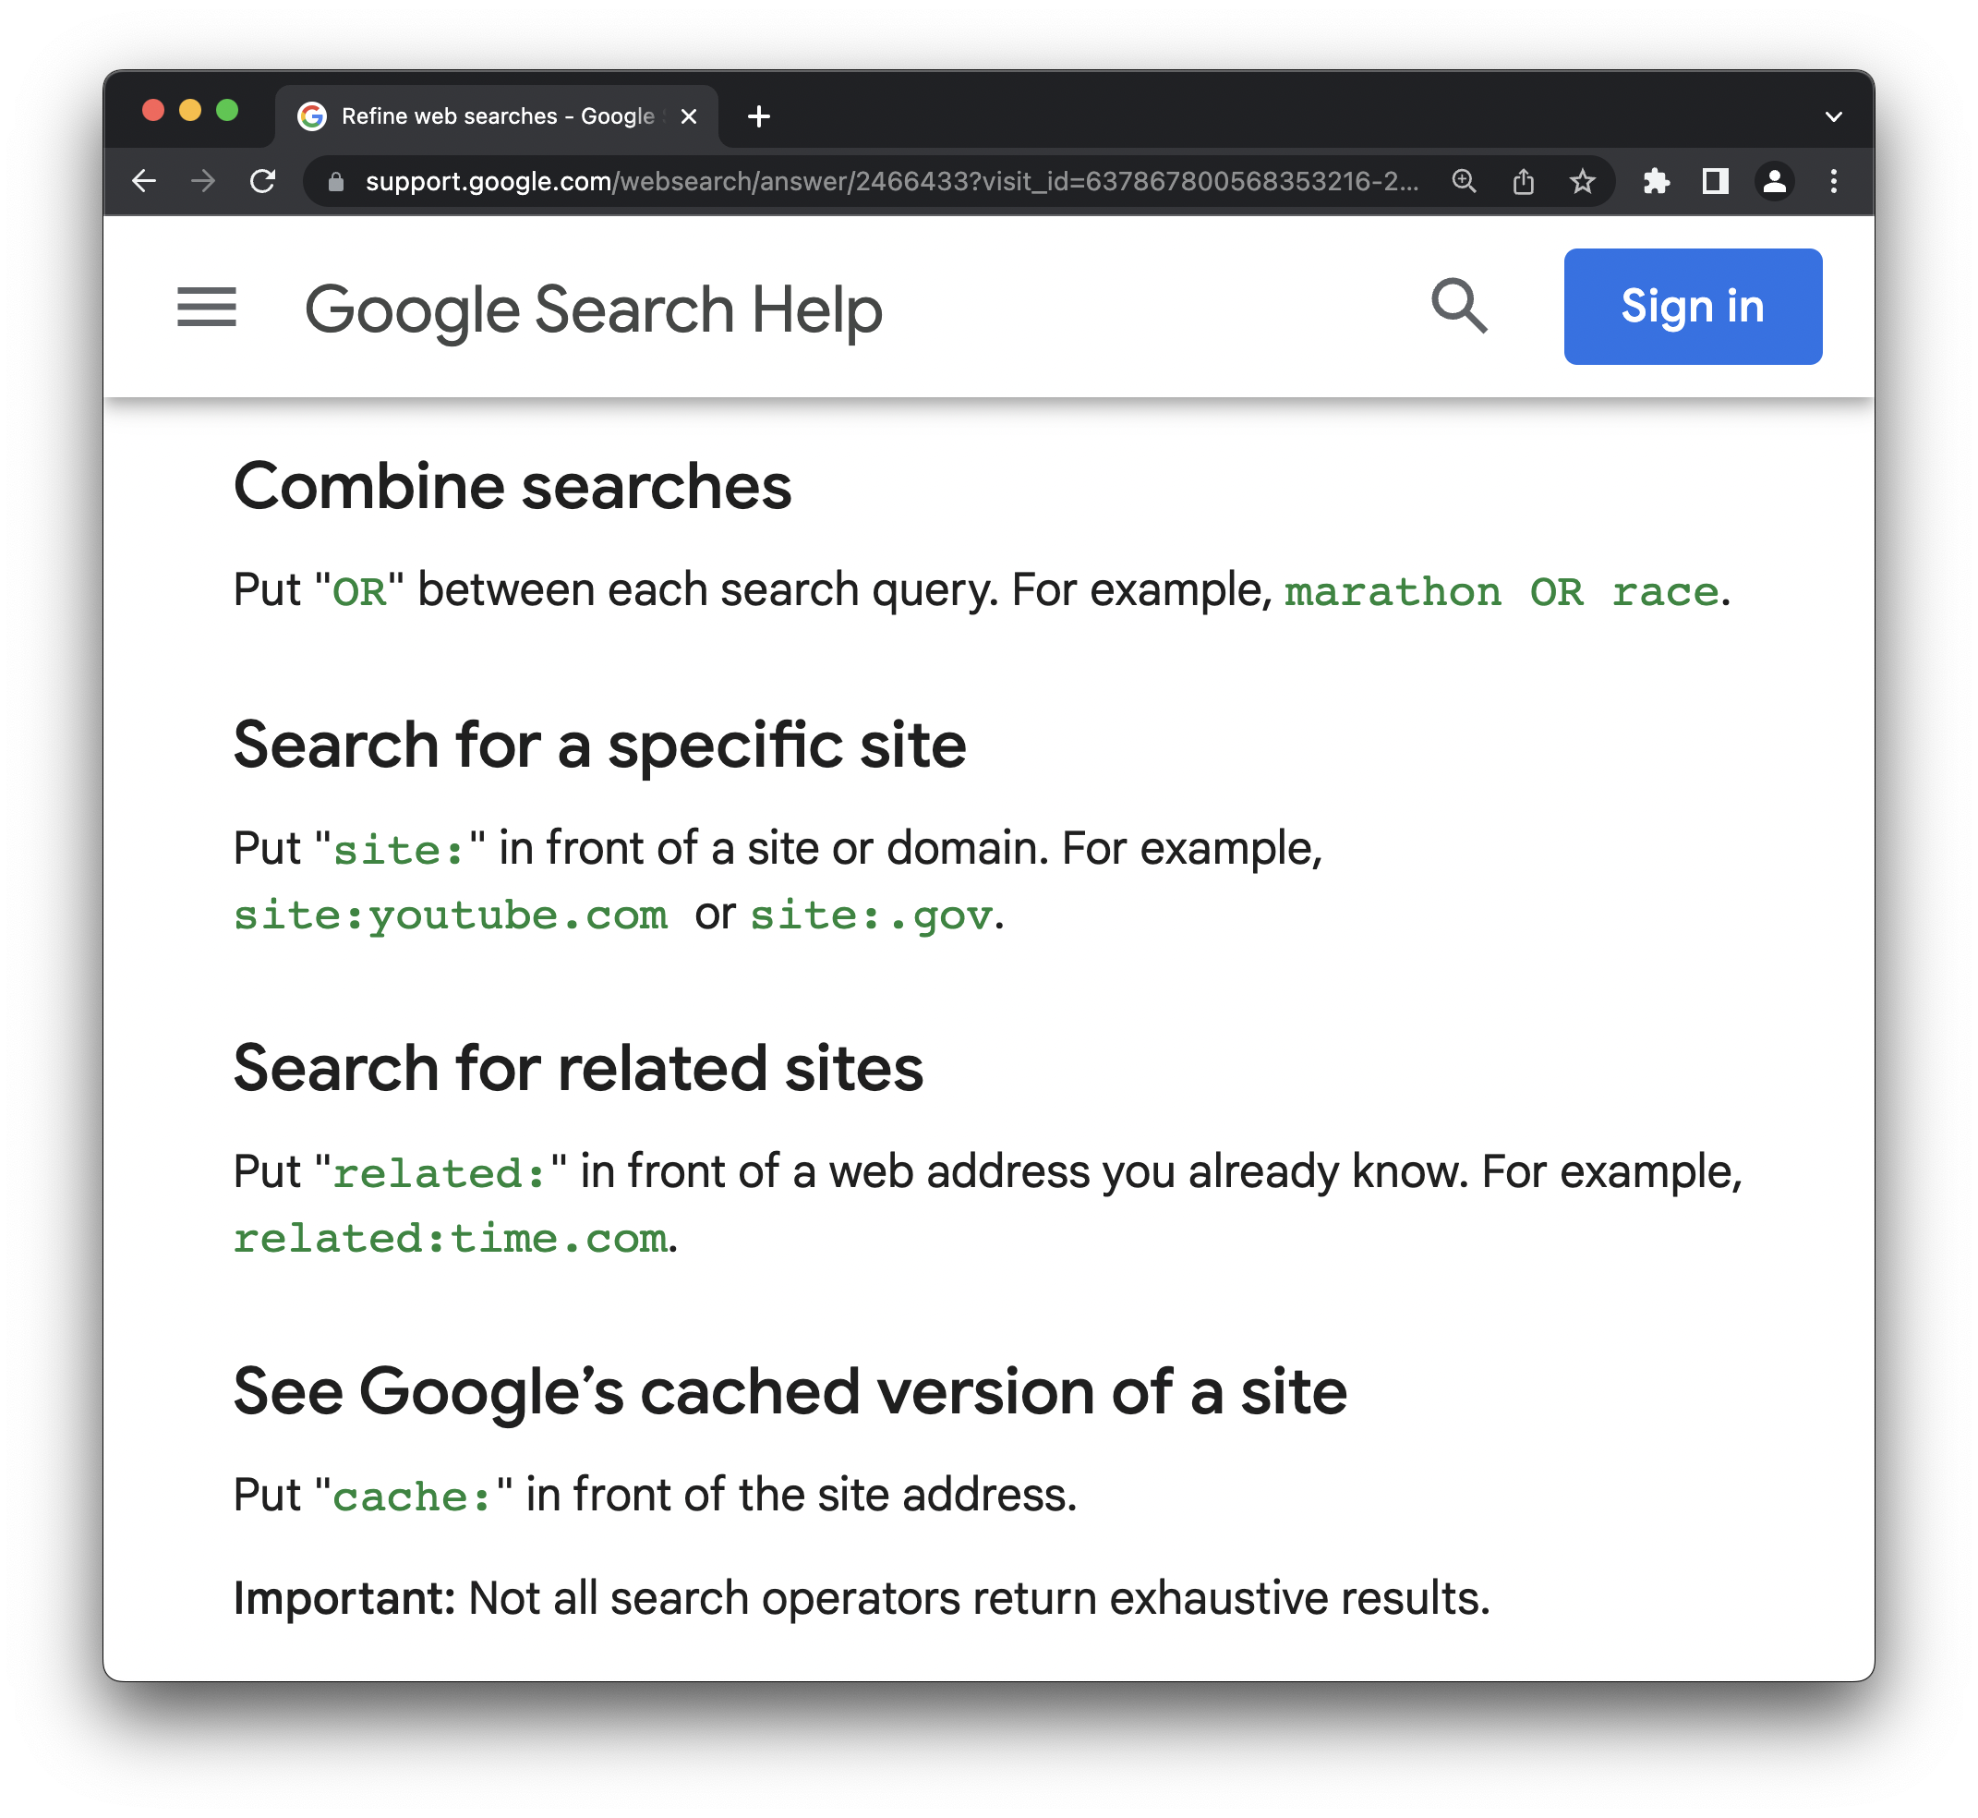
bonus - learn how to use google

Slide 71
how to become a better data enginner?
bonus - learn how to use google

Slide 72
how to become a better data enginner?
learn your IDE
7

Slide 73
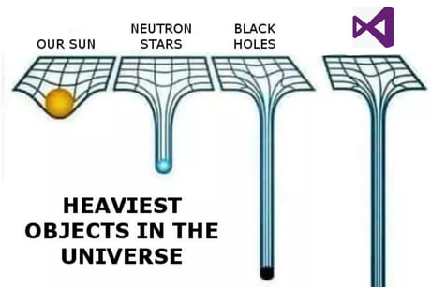
learn your IDE

Slide 74
how to become a better data enginner?
your basic tools

Slide 75
how to become a better data enginner?
more than simple text editor

Slide 76
how to become a better data enginner?
learn techniques, not tools?

Slide 77
how to become a better data enginner?
learn your IDE
7

Slide 78
how to become a better data enginner?
learn Excel
8
Notes:
Resources: https://www.reddit.com/r/excel/wiki/learningmegathread -> everything is in there

Slide 79
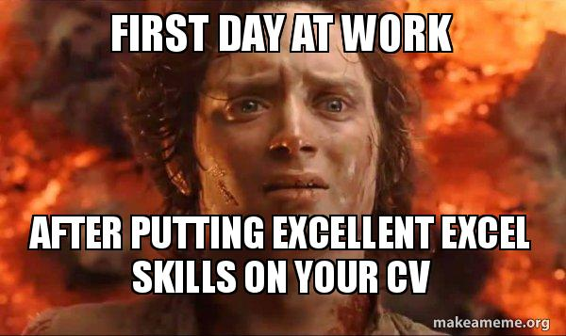
learn Excel

Slide 80
learn Excel
your brother in arms

Slide 81
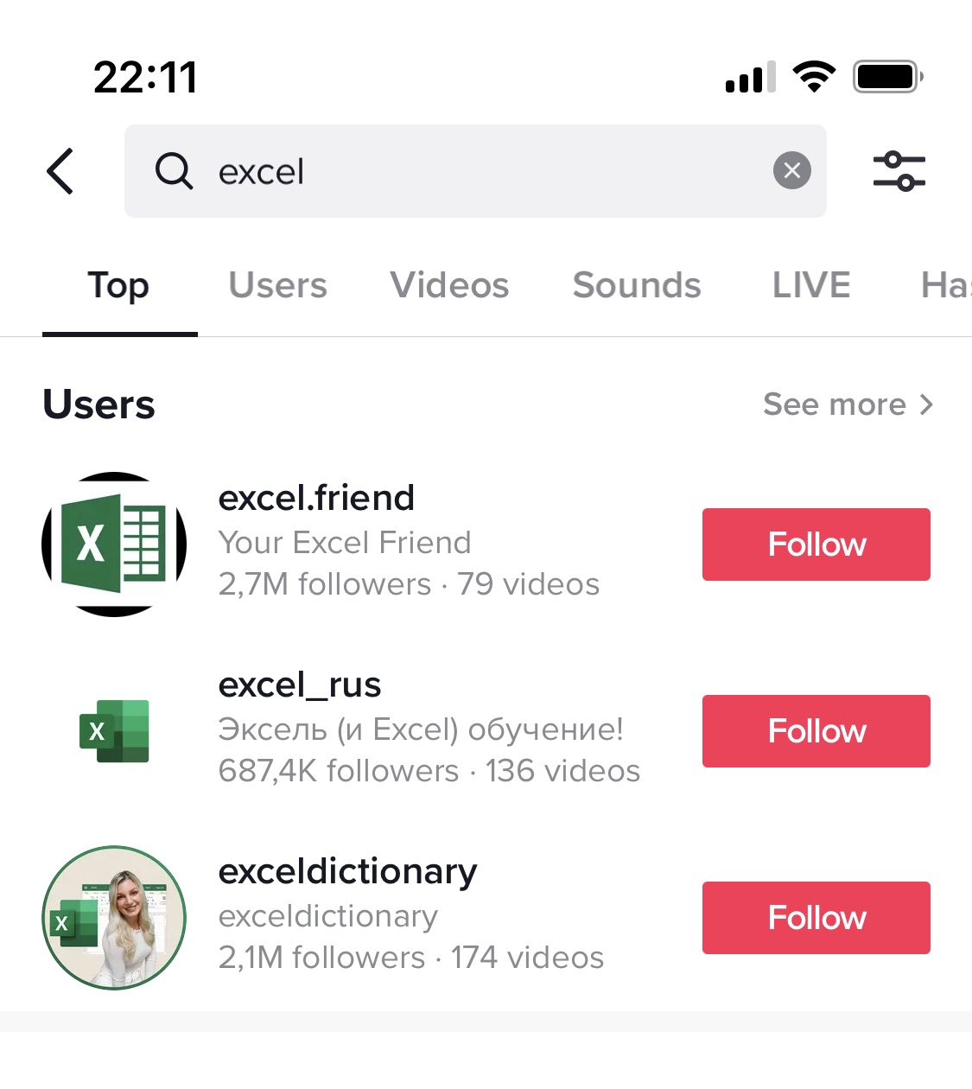
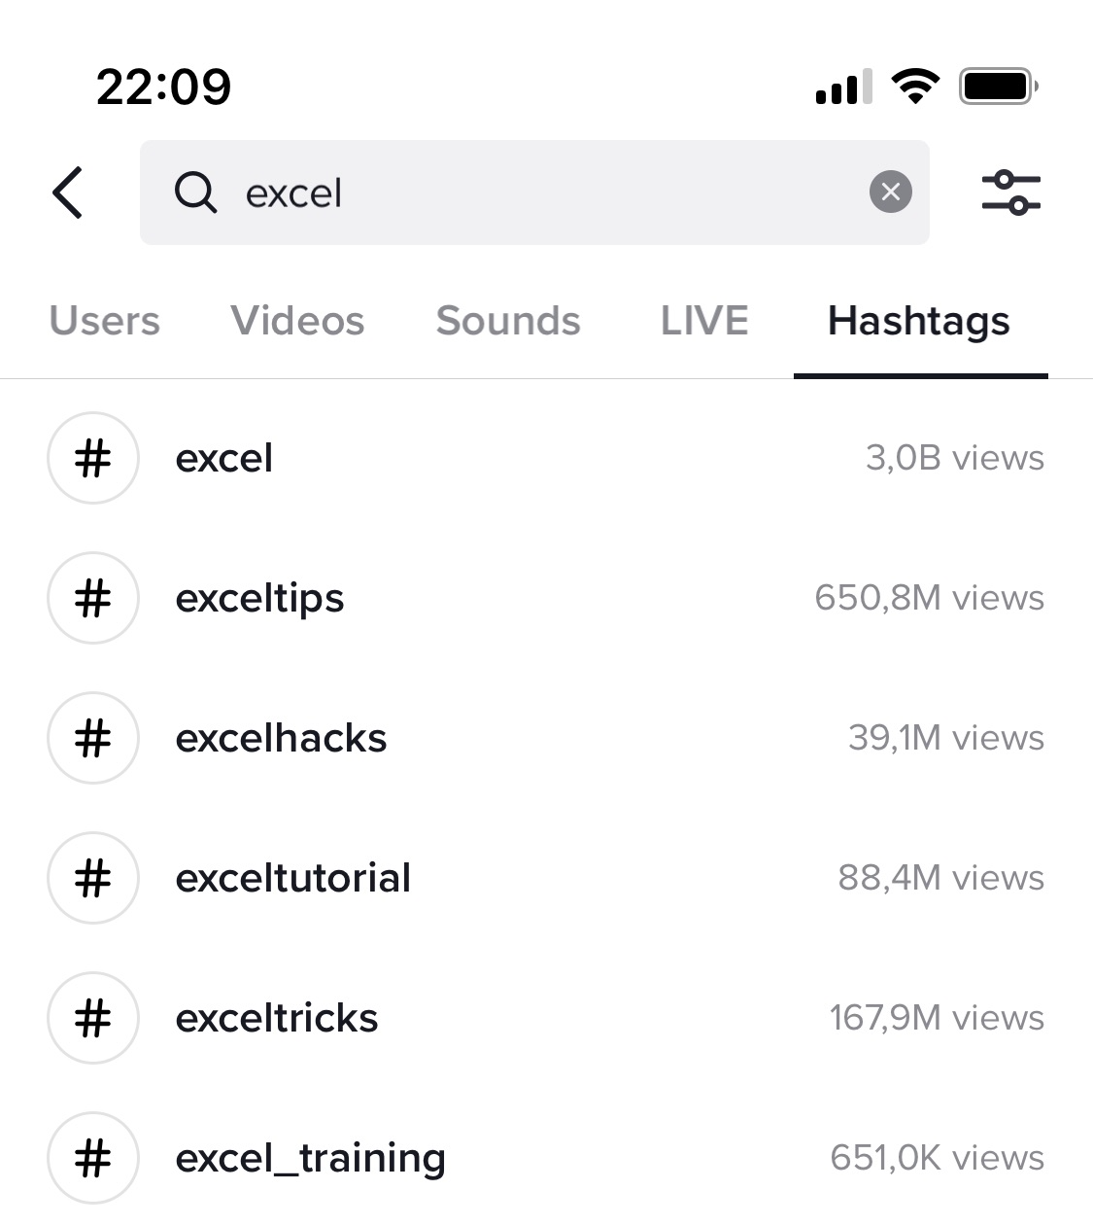
learn Excel

Slide 82
how to become a better data enginner?
learn Excel

Slide 83
how to become a better data enginner?
learn programming
9
Notes:
Resources:
https://www.codewars.com (online practice with multiple challanges)
https://www.reddit.com/r/learnpython/wiki/index

Slide 84
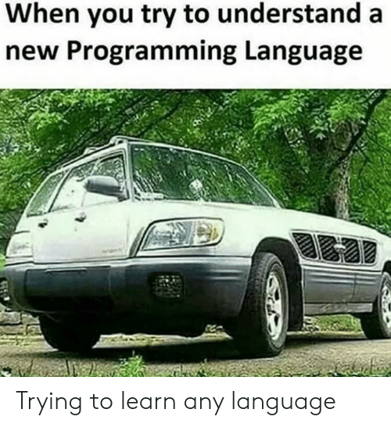
learn programming

Slide 85
learn programming
probably already required

Slide 86
learn programming
going to the cloud

Slide 87
learn programming
CICD

Slide 88
learn programming
but we have a DBA / Devops / etc

Slide 89
learn programming
game changer

Slide 90
learn programming
the basics

Slide 91
learn programming
C#, Python, Scala, R, PowerShell?

Slide 92
how to become a better data enginner?
learn programming
9

Slide 93
how to become a better data enginner?
don’t be a d**k
10

Slide 94
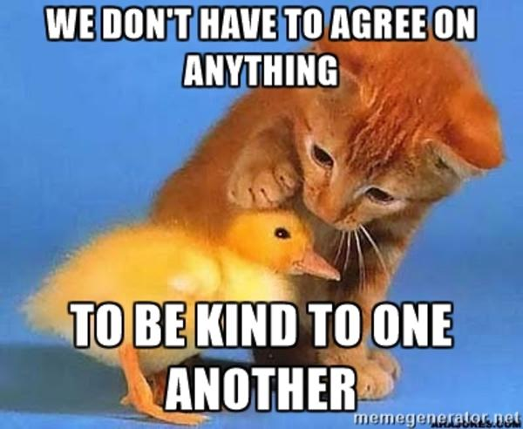
don’t be a d**k

Slide 95
how to become a better data enginner?
don’t be a d**k
10

Slide 96
how to become a better data enginner?
my top 10 what to do? what to learn?

Slide 97
how to become a better data enginner?
check the slide deck

Slide 98
how to become a better data enginner?
other great tips

Slide 99
how to become a better data enginner?
test
connect the dots
Focus mainly on one technology first. There are few people who are specialists in one technology
Learn from your mistakes and avoid them.
Practice, practice, practice
Learn Azure ETL and Modeling tools
Keep calm
learn and practice
Think as a machine
Learn at least 3 different etl tools to have your own view on possibilities
do things, don't be afraid of mistakes but make conclusions out of them
Learn from your mistakes.
Don't be afraid of new things
You should know your data from inside
książki, kursy, materiały wideo
You can watch and read as much as you want. At the end of the day, do it hands-on.
It's important to start from basic data knowledge, such as the books from Inmon and Kimbal
Work on your toolbox
Data quality, tested your data. Ask your client about what's they want
Always check your data twice!
Attend SQLDay.
Work on your people skills as much as your technical knowledge.

Slide 100
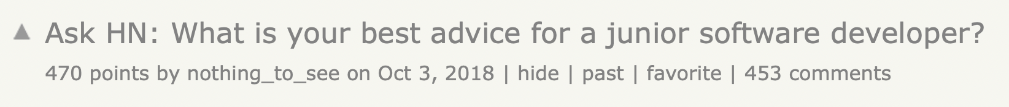
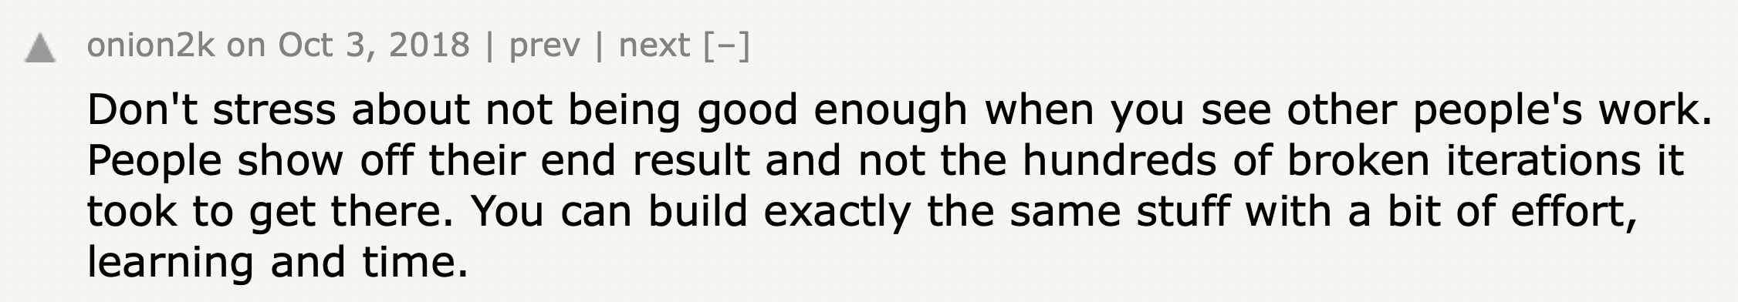
how to become a better data engineer?
https://news.ycombinator.com/item?id=18128477
Notes:
https://news.ycombinator.com/item?id=18128477

Slide 101
how to become a better data enginner?
good luck!

Slide 102
how to become a better data enginner?
thank you!

